Slide 1
carpETHii BETH Hackathon 2019
Wassim Dhaouadi
Marc-Philippe Frey
Vladimir Michalec
Michael Weinold
Yoel Zweig

Slide 2
Stakeholders donate money to WWF and receive a Decision Token in return.
WWF splits the money into two pots. One is used to cover the expenses of WWF’s activities including bison transportation, set-up of sensors, etc. The remaining money is combined into a community pot on Blockchain.
The overall state of the ecosystem is measured through Performance Indicators such as the number of bison or the level of deforestation.
The Stakeholders distribute their Decision Tokens to the projects (=Performance Indicators) that interest them the most, creating a weighting.
Community members can register for a given task and complete it. Once the task is completed, there are two ways to verify it. Some tasks are sensor related, others require community validation. Tasks that allow automatic verification, such as through GPS data, get verified automatically.
Alternatively, the community votes on the task completion to verify it
Through the completion of the task, the community member receives a Voting Token and a Finance Token. The Finance Token is a cash alternative that is redeemed with WWF directly.
The Voting Token is used by the community members to cast their vote towards a community project they would like to have realized (Voting Tokens can only be used once)
At regular intervals, sensor and task information are used to determine the health of the state of the environment through a smart contract. The details are explained on the next slide.
The determination of the state then triggers the Smart Contract that releases the funds to the most voted community project.

Slide 3
Stakeholders donate money to WWF and receive Decision Tokens in return
Investors allocate the Decision Tokens to their desired performance indicator. These votes will then be used as a weighting mechanism for final pay-out of the allocated donations.
The overall state of the ecosystem is measured through Performance Indicators such as the number of bison or the level of deforestation.
Using sensor data, the ‘health’ of the Performance Indicators is evaluated against a predefined baseline. This is shown in red on the Performance Dial.
The Performance Function inside the smart contract uses the ‘health’ of the indicator, the number of tasks completed by the community, and the weighting assigned by the Stakeholders.
The result is the weighted contribution of the indicators. This is shown in yellow on the performance dial.
This weighted performance determines the subsequent pay-out through the next smart contract shown on the overview slide.

Slide 5
Benefits and Challenges
System Design
The rewards are divided into short-term rewards and long-term rewards to enable continuous involvement
Community can define own tasks which will be rewarded as well
Anyone can claim task and complete it (no hunter/community split)
Task completion auto-checked or voted by the community (incentive to vote, task completed increases funding)
All parties incentivized to cooperate (carrying out tasks provides direct reward with right to vote for local sub-community projects / anyone completing task increases the funds for all the projects)
Transparency on the progress and state of the environment for all stakeholders (can give subjective judgement of the ecosystem)
The configuration of the state function acts as a watchdog against collusion between community members
Blockchain
The blockchain technology ensures that the decision making is concentrated amongst the most active members
Decentralized governance that allows merit-based reward distribution
Off chain
Provide outdoor screen panels showing current ecosystem performance
Use graphical representation (smiling/crying bison) to foster emotional response
Show ranking of the people who have done most tasks (to foster competition for the good thing)
Implementation Challenges
Validation of the tasks is dependent on the members of the community and can be falsified (if all the sub-communities tried to cheat the system, but we rely on internal competition)
The technology might fact regulatory and social resistance hindering the effectiveness of the implementation
Community members must posses access to Smartphones and Signal in all parts of the Area
Avenues for Future Work
Interfacing the Website with the Blockchain
Application for the community members
Create Community interface to allow for effective assignment and creation of tasks
Creation and implementation of additional sensor indicators (Soil samples, air quality, etc.)

Slide 6
Sensor and IoT Implementation

Slide 7
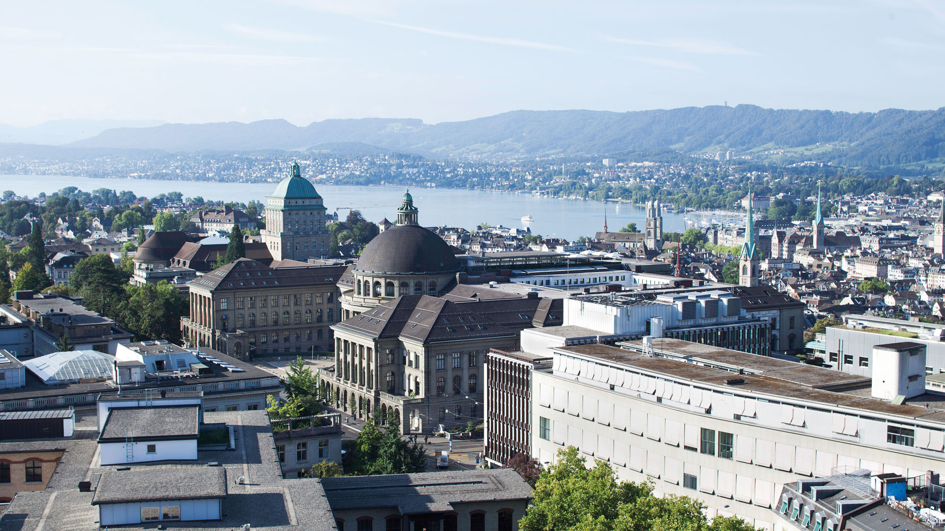
Thank you for your attention.
#carpETHii #BETH #ethz

